Slide 1
FINAL PROJECT
REPORT
Marco Britton
Brendon Lee
Fall 2025
SI 201
Group name: Rush Hour

Slide 2
Project goal:
To analyze the correlation between local weather and the number of breweries in different cities using public APIs. We seek to determine whether warmer cities tend to have more breweries than colder ones.
APIs :
https://api.open-meteo.com/v1/forecast (open-meteo)
https://api.openbrewerydb.org/v1/breweries (open-brewery DB)
Project Goal, API plan

Slide 3
We successfully used the planned APIs to grab datas from open-brewery DB and open-meteo. We gathered the total number of breweries from Ann Arbor, MI and then Dallas, TX and 109 days of historical local weather temps of to calculate and visualize the data.
APIs :
https://api.open-meteo.com/v1/forecast (open-meteo)
https://api.openbrewerydb.org/v1/breweries (open-brewery DB)
Goal Achieved

Slide 4
Problems faced
Finding free and usable APIs
Duplicate string data in dataset
Which calculations to use
Uploading/sharing files into one shared github repository

Slide 5
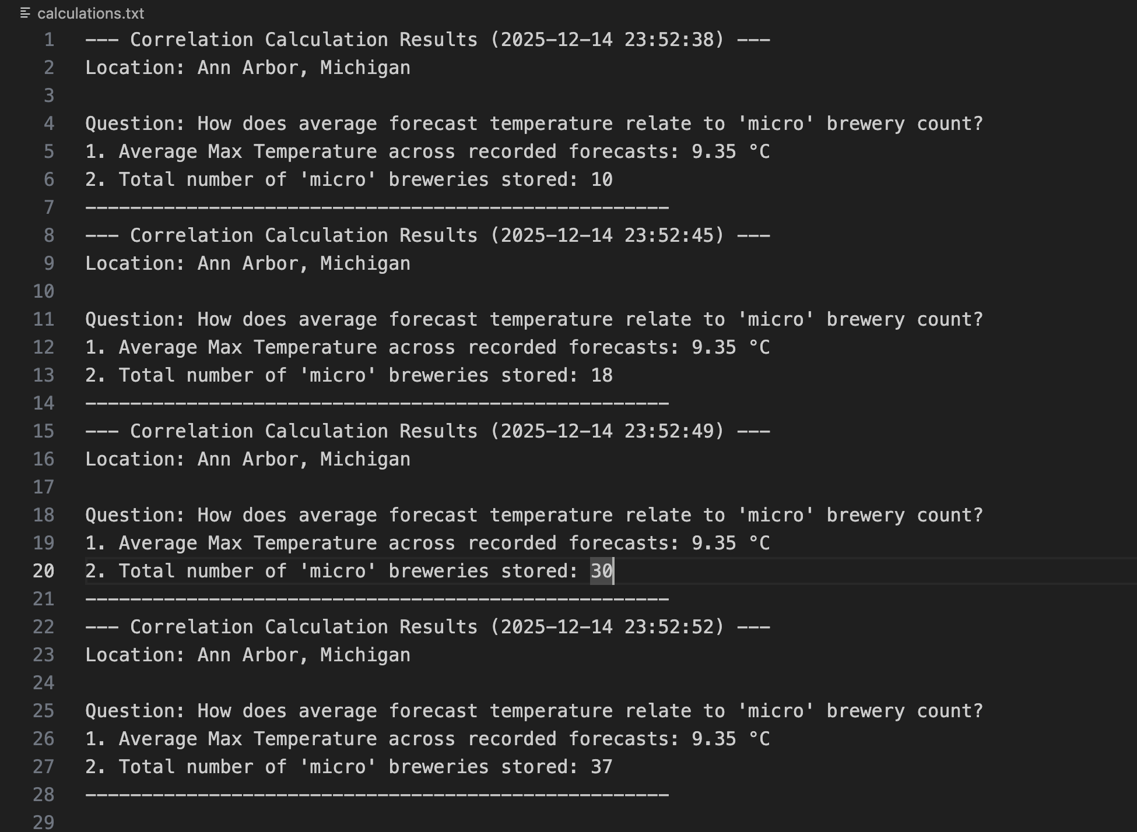
Calculation

Slide 6
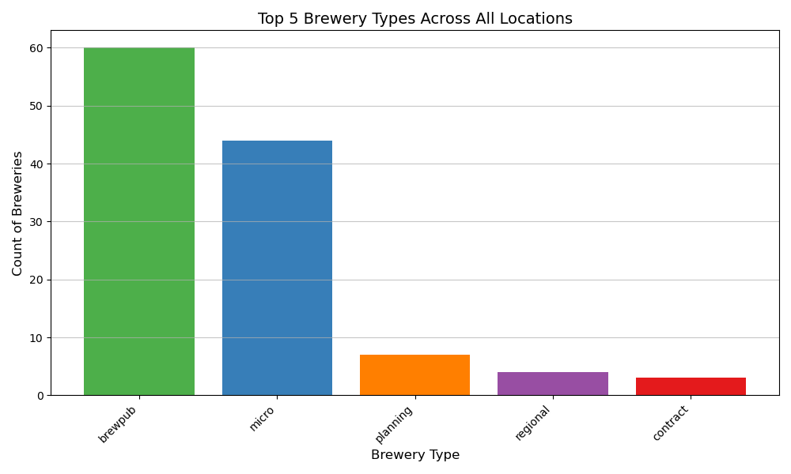
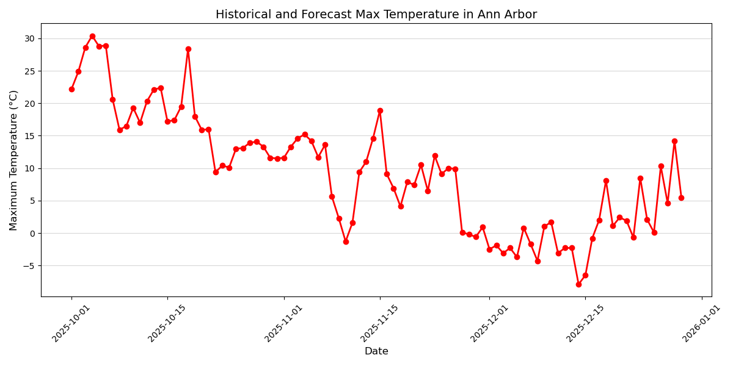
Visualization

Slide 7
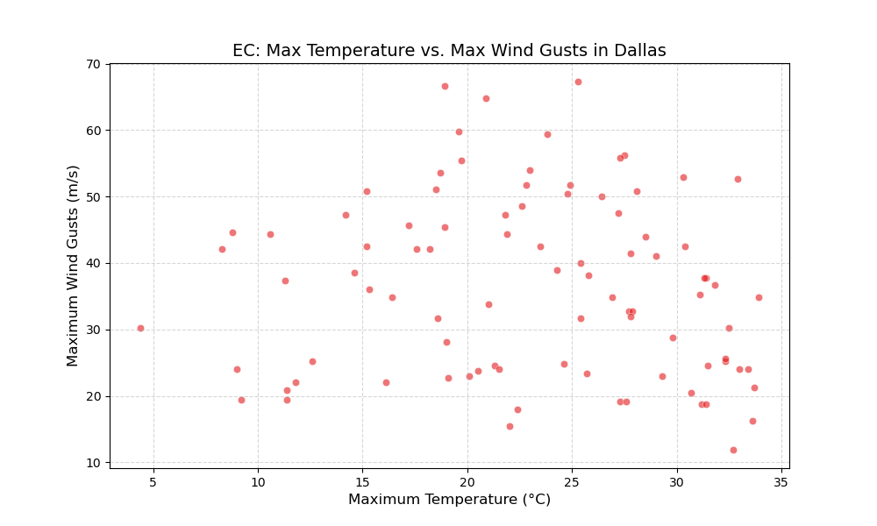
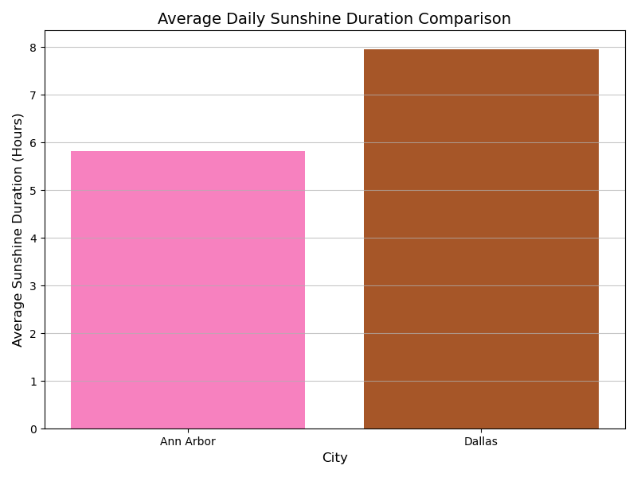
Visualization (Extra Credit)

Slide 8
Instructions For Running Code
For each run of code the program will add up to 25 new brewery records per city and update visualizations accordingly.
Check the visualization images and Calculation.txt after each run.
Run the code 4 times for 100+ datasets
Lastly, open the brewery_weather_db1.sqlite file with “DB browser for SQLite” to display the fetched data visually.

Slide 9
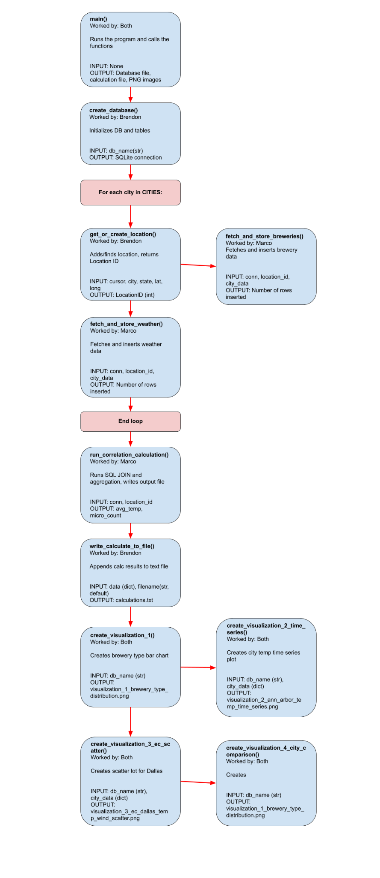
Function Diagram

Slide 10
Documentation Of Resources Used
df
Date | Issue Description | Location of resource | Result
12/3 | Finding usable APIs | Github public APIs | Found APIs
12/10 | Working on project, debugging | Runestone, Gen AI, past discussions & homeworks | Fixed
12/13 | Found duplicate entry data in database | Runestone, Gen AI, past discussions & homeworks | Fixed

Slide 11
Link to GitHub Repository
https://github.com/AgentBoom007/Rush-Hour.git
df

Slide 12
THANK YOU

